Slide 1

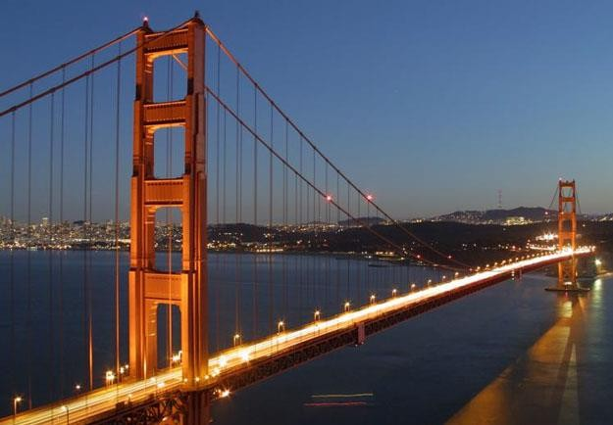
DESIGN OF BRIDGES
17CV741
Mr. Shiva Prathap H K
B.E., M.Tech
Assistant Professor
DEPARTMENT OF CIVIL ENGINEERING BGSIT, BG Nagara

Slide 2
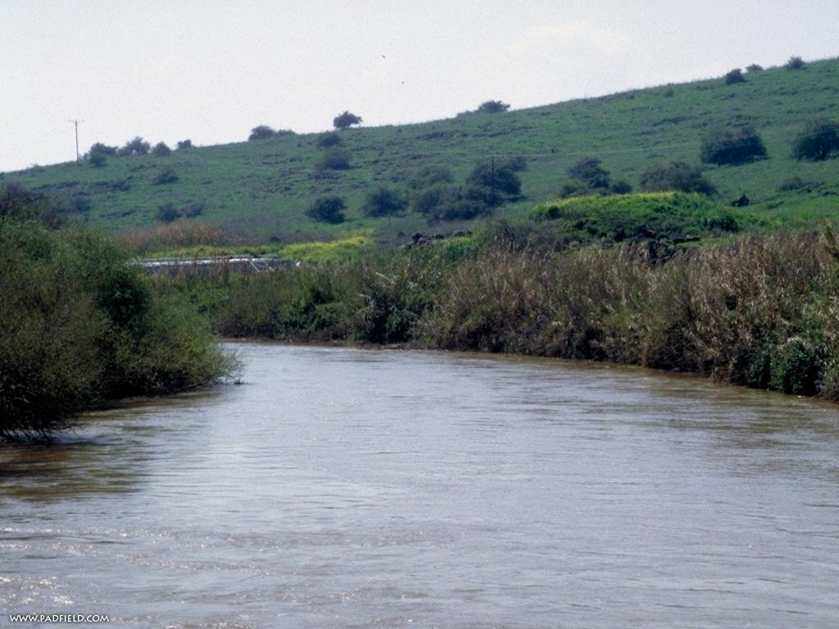
What is a Bridge?
A structure built to span a valley, road, body of water or other physical obstacle for the purpose of passing over the obstacle.

Slide 3
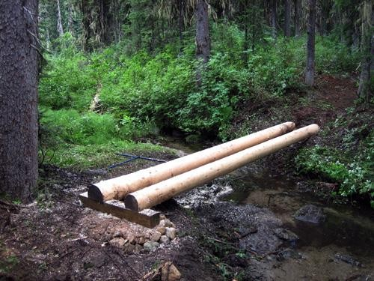
History
The first bridges were made by nature itself. ex- a fallen tree over a stream.
Humans then began placing logs or planks across gaps they wanted to cross

Slide 4
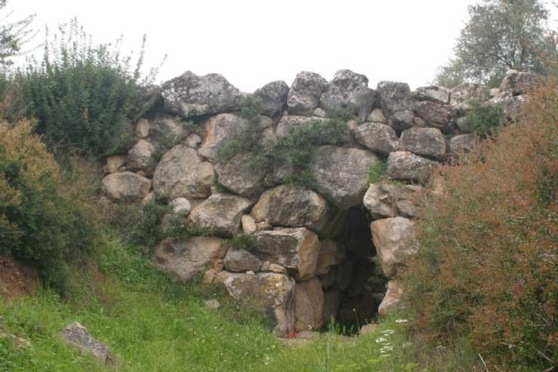
History (cont’d)
The first complex bridges built were done by the ancient Greeks and Romans in the 13th century.
Some of these are still standing!

Slide 5
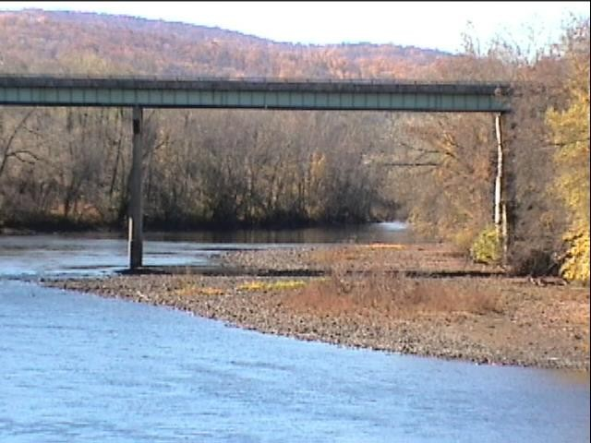
Beam Bridge:
Horizontal beams supported at each end by piers. The weight at the top of the beam pushes straight down onto the piers.

Slide 6
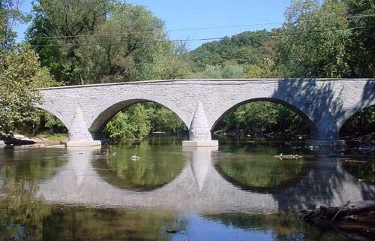
Arch Bridge:
Arch-shaped and have abutments at each end.
The weight of the bridge is thrust into the abutments at either side.

Slide 7
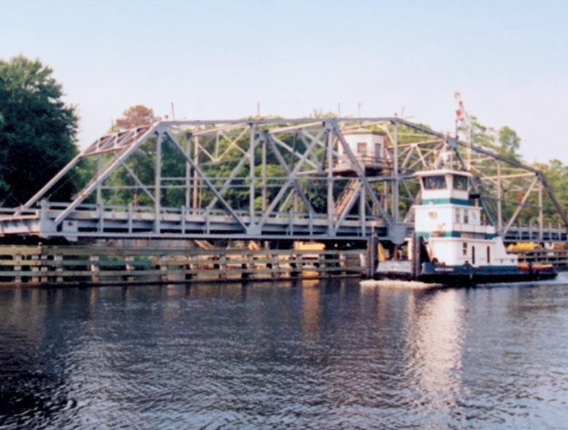
Truss Bridge:
Trusses are used to stiffen and support a bridge by distributing the loads and forces acting upon the bridge based on the positions of the vertical, horizontal and diagonal chords.

Slide 8
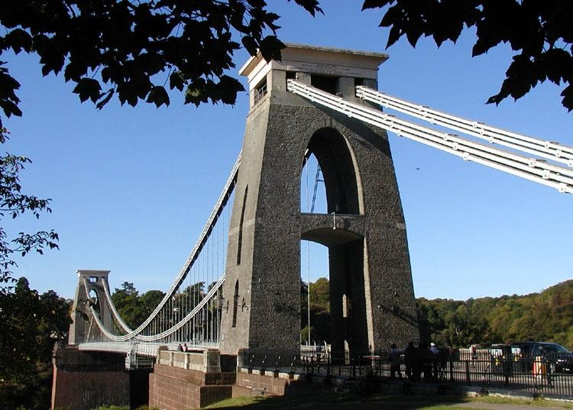
Suspension Bridge:
Has cables suspended between towers, plus vertical suspenders which carry the weight of the deck (load bearing portion).

Slide 9
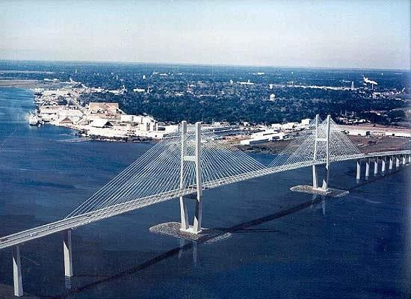
Cable-Stayed Bridge:
Like suspension bridges, cable-stayed bridges are held up by cables.
However, in a cable-stayed bridge, less cable is required and the towers holding the cables are proportionately shorter.

Slide 10
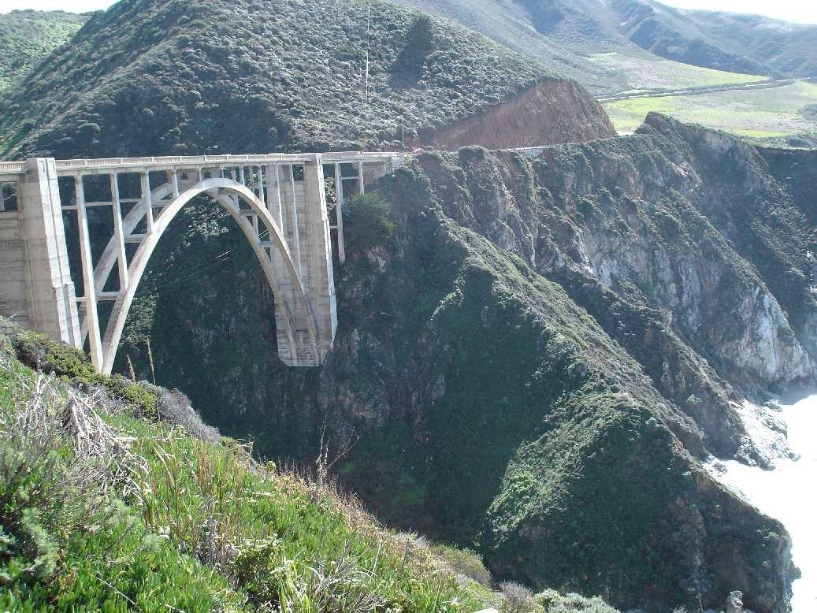
Big Sur Bridge, California

Slide 11
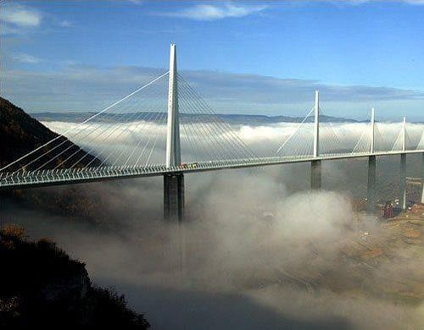
Millau Bridge, France

Slide 12
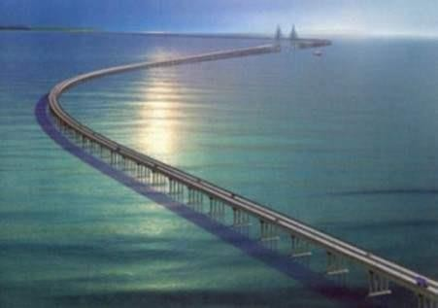
Donghai Bridge, China

Slide 13
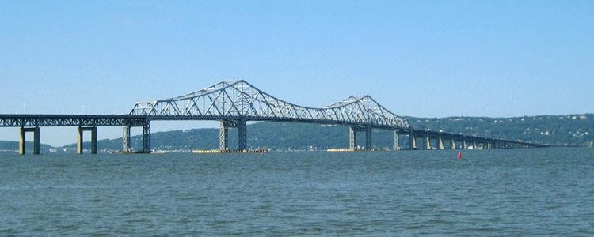
Tappan Zee Bridge, NY

Slide 14
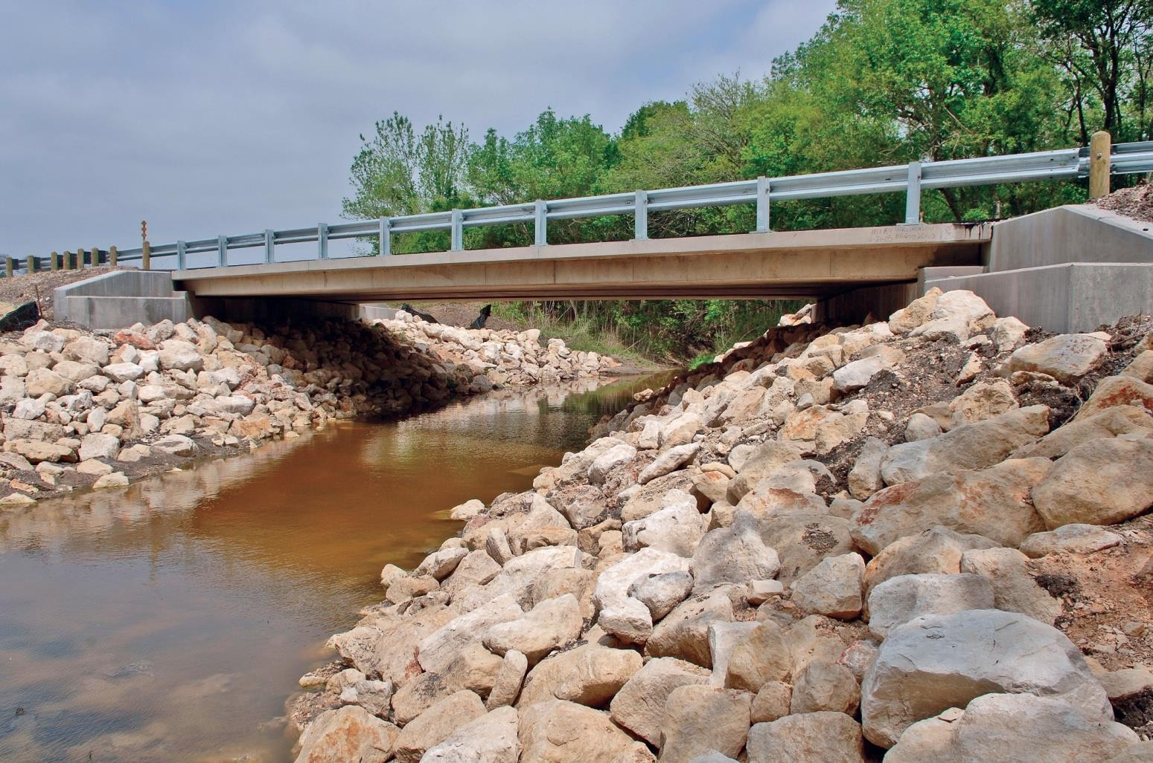
Battle Ground Bridge, Washington

Slide 15
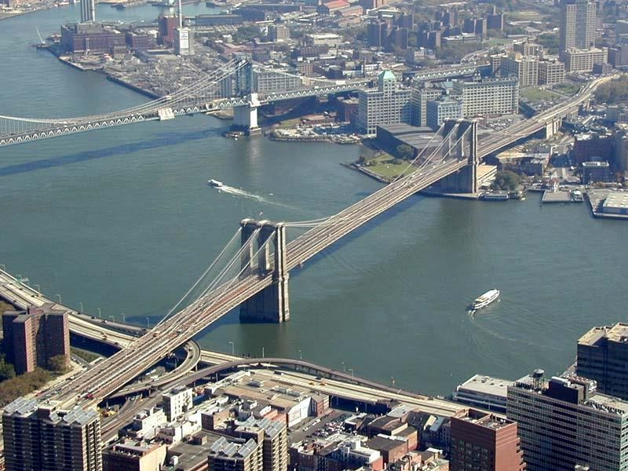
Brooklyn and Manhattan Bridge, NYC.

Slide 16
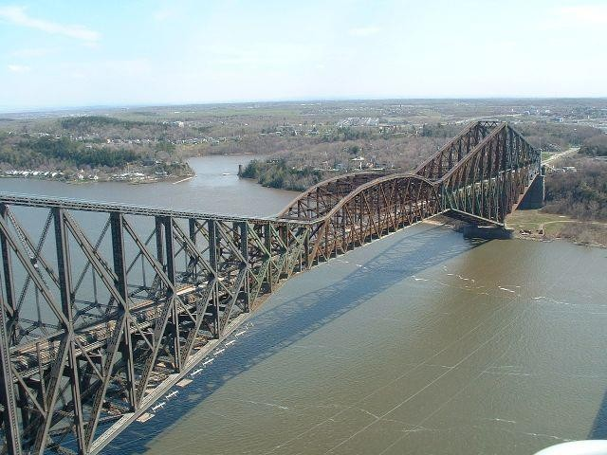
Pont De Quebec Bridge, Canada

Slide 17
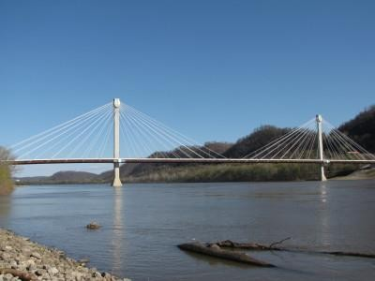
Grant Memorial Bridge, Ohio

Slide 18
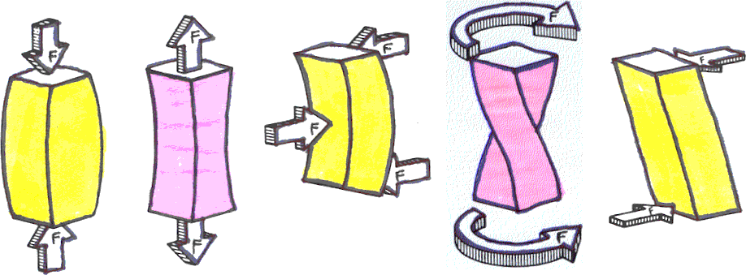
Forces Acting On A Bridge:
Compression
Tension
Bending
Torsion
Shearing

Slide 19
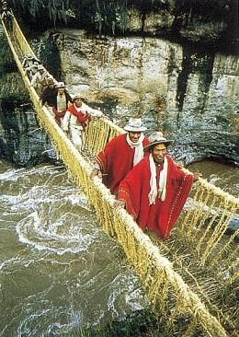
Some U s e s of Bridges
Walkways
Highways/Roads
Railways
Pipelines
Connecting lands
Crossing rivers and canyons

Slide 20
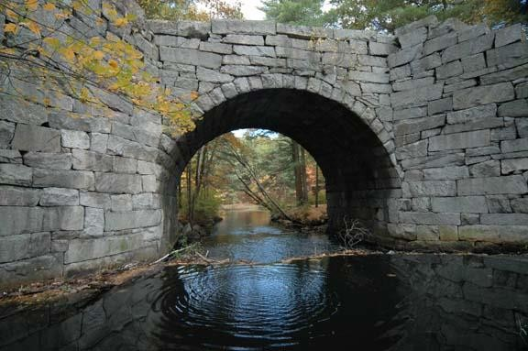
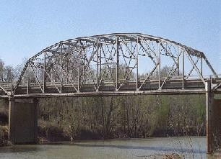
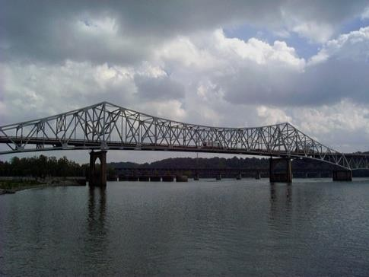
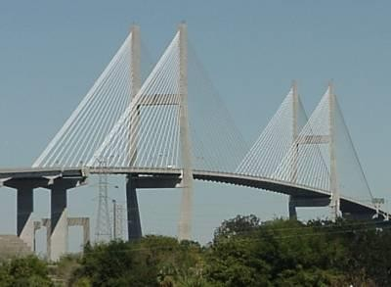
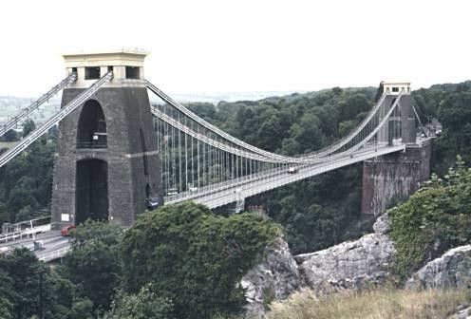
Types of Bridges
Arch
Truss
Cantilever
Cable-Stayed
Suspension

Slide 21
What makes a bridge stay up?
Forces
  Compression – a pushing or squeezing force
  Tension – a pulling or stretching force
Demonstration
  Make groups of two…

Slide 22
Arch Bridges
Keystone – the wedge- shaped stone of an arch that locks its parts together
Abutments – the structures that support the ends of the bridge

Slide 23
Arch Bridges
Works by Compression

Slide 24
Arch Bridges
Where have you seen these bridges?

Slide 25
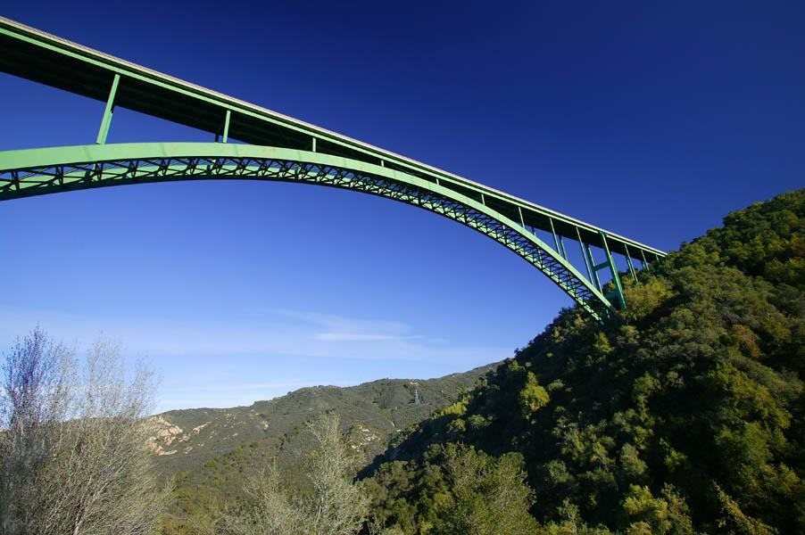
Cold Spring Arch Bridge, Santa Barbara, CA

Slide 26
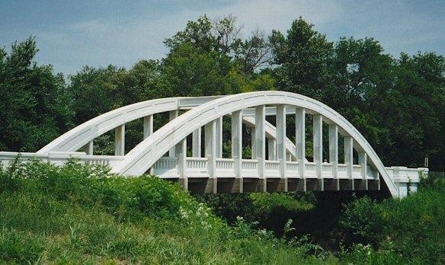
Marsh Rainbow Arch, Riverton, KS

Slide 27
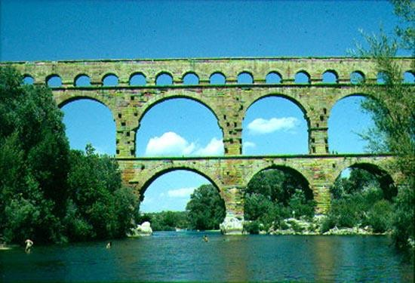
Pont du Gard, Nimes, France

Slide 28
Cable-Stayed Bridges
Piers – the vertical supporting structures
Cables – thick steel ropes from which the decking is suspended
Decking – the supported roadway on a bridge

Slide 29
Cable-Stayed Bridges
Works by Tension AND Compression

Slide 30
Cable-Stayed Bridges
Where have you seen these bridges?

Slide 31
Suspension Bridges
Similar to Cable-Stayed
Different construction method

Slide 32
Suspension Bridges
Works by Tension and Compression

Slide 33
Suspension Bridges
Where have you seen these bridges?

Slide 34
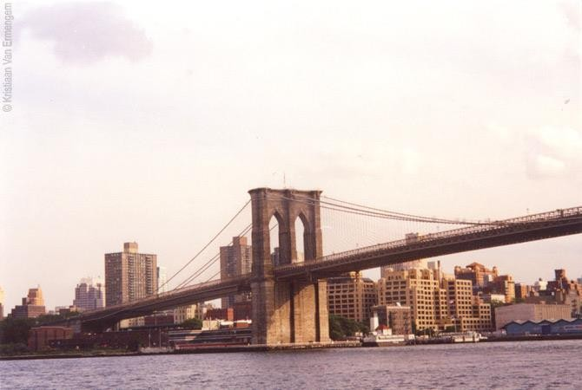
Brooklyn Bridge, Brooklyn, NY

Slide 35
Arch Bridges
An arch bridge is a type of bridge that relies on a curved, semi-circular structure for its support.

Slide 36
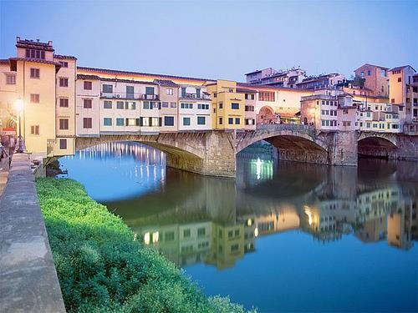
The Ponte Vecchio (literally “old bridge”) is a Medieval bridge over the Arno River in Florence; the only Florentine bridge to survive WWII

Slide 37
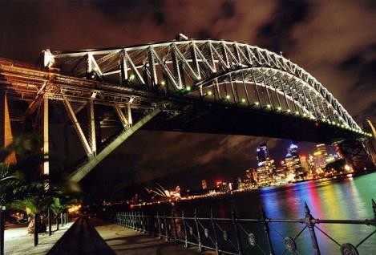
Sydney Harbor Bridge is the world’s largest (but not the longest) steel arch bridge with the top of the bridge standing 134 meters above Sydney Harbor

Slide 38
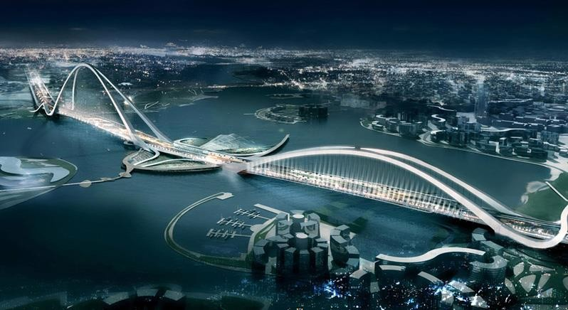
NY architecture firm Fxfowle is designing what will be the largest and tallest arch bridge in the world, at one mile long and 670 feet tall with a price tag of$817 million dollars.

Slide 39
Cable Stayed Bridges
A cable-stayed bridge has one or more towers (or pylons), from which cables support the bridge deck

Slide 40
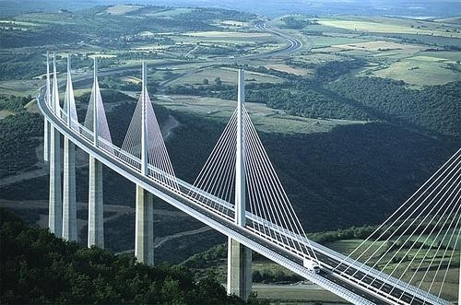
The Millau Viaduct (“le Viaduc de Millau”, in French) spans the River Tarn valley near the medieval town of Millau in southern France

Slide 41
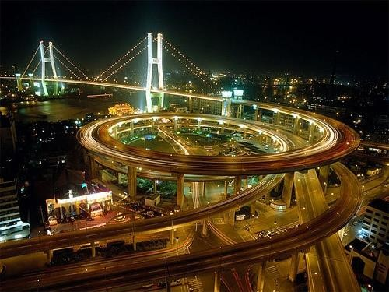
Nanpu Bridge was made to minimize the amount of land used by the bridge approach

Slide 42
Truss Bridges
The basic truss design consists of three basic components: the piers, the chords and the diagonal "webs" that give the truss its distinctive, triangular-webbed appearance. More elaborate truss bridges may also sport struts, sway bracing and wind bracing

Slide 43
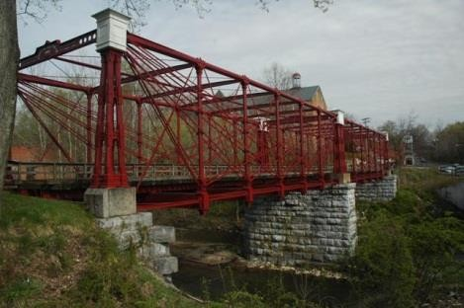
The design of the Bollman Truss Bridge- patented in 1852 and one of the first to use iron exclusively in all essential structural elements-was critical in the rapid expansion of American railroads in the 19th century

Slide 44
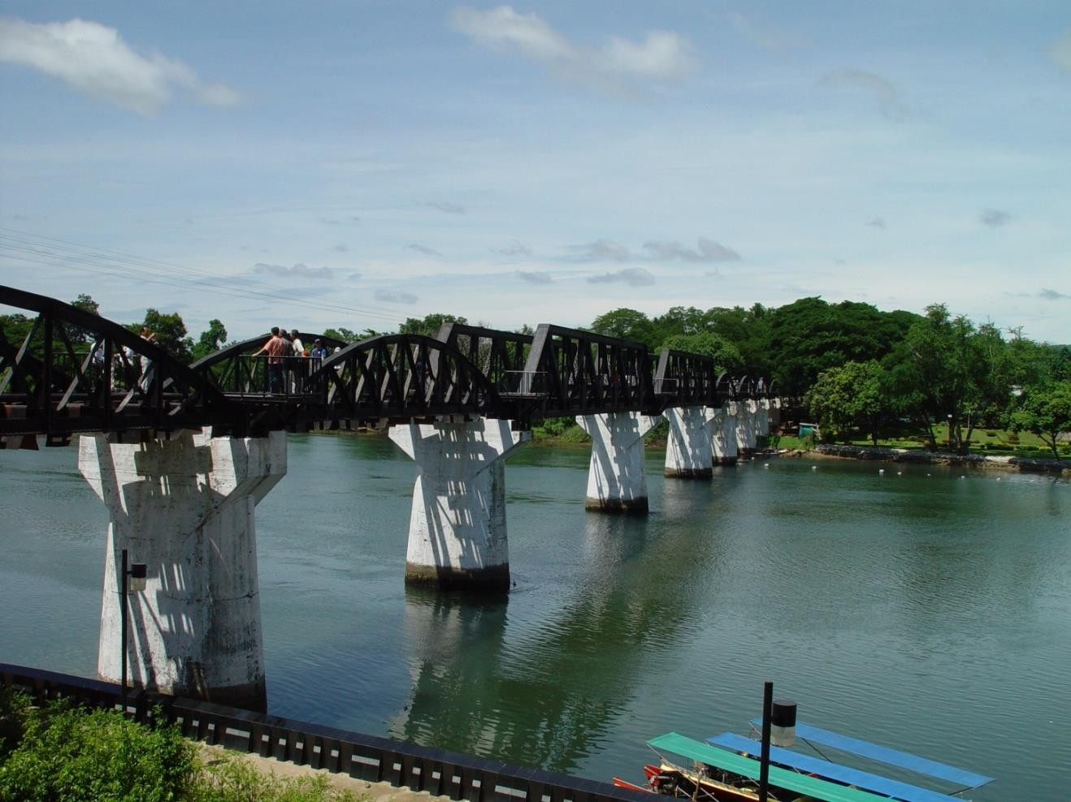
The Bridge on the River Kwai is a 1957 British-American World War II film. The film is based in Japan but the bridge is actually in
Thailand

Slide 45
Beam Bridges
A beam bridge, sometimes called a girder bridge, is a rigid structure that consists of one horizontal beam supported at each end, usually by some kind of pillar or pier.

Slide 46
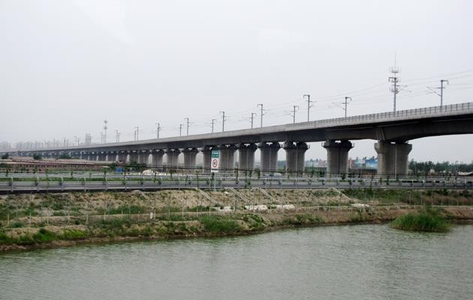
The Manchac swamp bridge in Louisiana is the 2nd longest in the United States, which carries Interstate 55 across the swamps

Slide 47
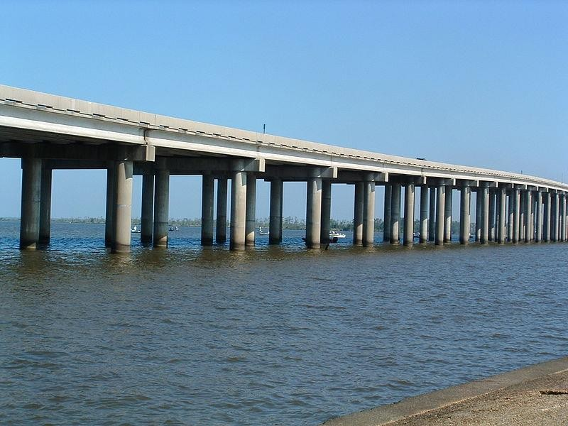
The Tianjin Grand bridge is one of the youngest and also the second longest of all bridges and is a sea link

Slide 48
Tilt Bridge
A tilt bridge is a type of moveable bridge which rotates about fixed endpoints rather than lifting or bending

Slide 49
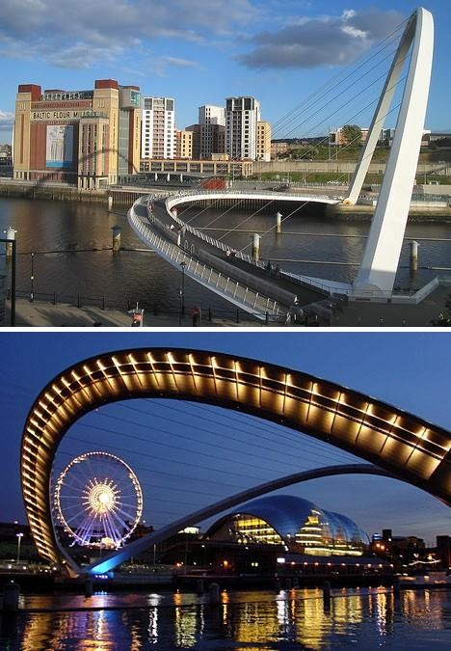
The Gateshead Millennium Bridge is the world's first and currently only tilting bridge

Slide 50
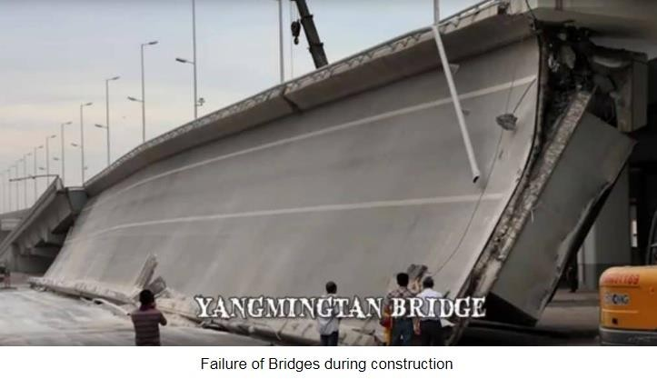
Failure of Bridges
Total or partial failure of bridges or collapse is often wrongly attributed to poor or improper design alone.

Slide 51
Common Reasons for Bridge Failures
Failure during construction
A combination of issues
Infrastructure issues
Floods
Unexpected events
Accidents
Design flaws and manufacturing errors
Fires
Earthquakes

Slide 52
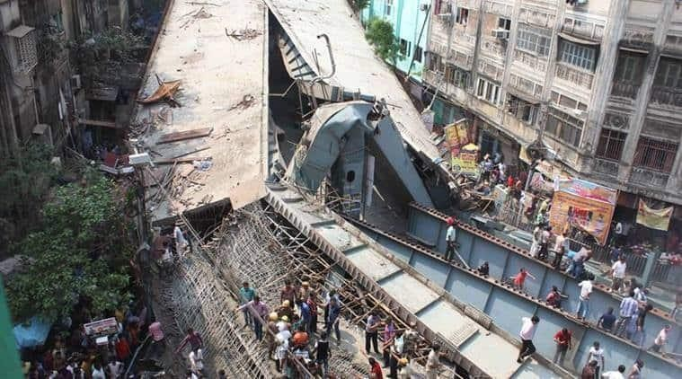
Failure during construction
Lack of expertise and experience
of site
engineers can be reasons apart
most from
common
instability issues during construction.
In steel bridges, buckling is most common cause of collapse during erection if the actual lateral supports are weaker or doesn’t reflect the one assumed in the design.
Insufficient bearing capacity of soil due to improper ground treatment can be a reason.

Slide 53
Reasons of collapse during construction
Overstressing of load bearing structure during longitudinal jacking
Construction defect joints of members in gusset plate.
Failure of support during cantilever construction.
Failure of lifting devices during cantilever erection
Lateral buckling of bottom flange
Construction defect noticed but not remedied.
Underestimation of friction force

Slide 54
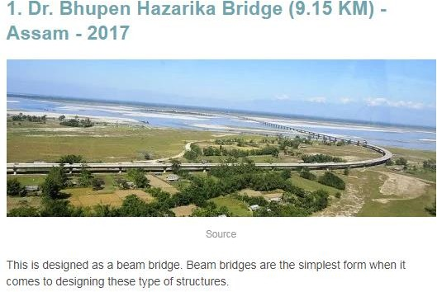
Top 10 Longest and Most Amazing Bridges in India

Slide 55
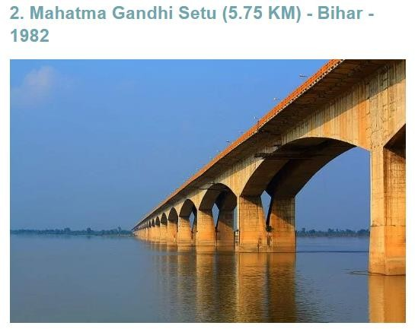

Slide 56
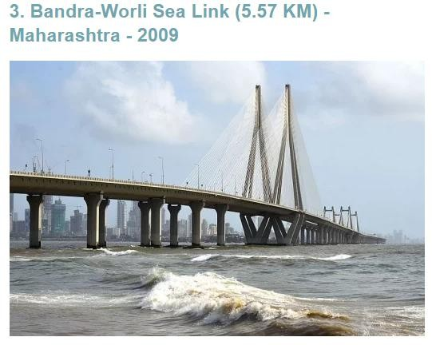

Slide 57
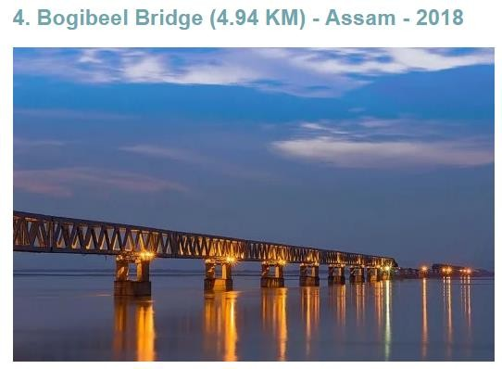

Slide 58
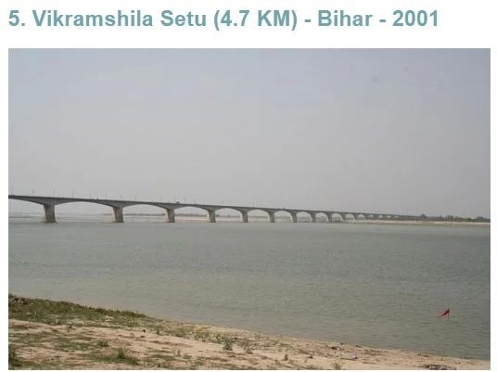

Slide 59
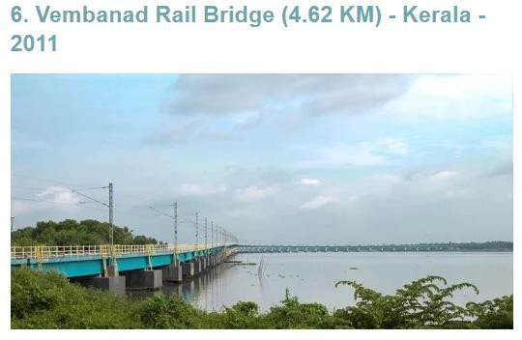

Slide 60
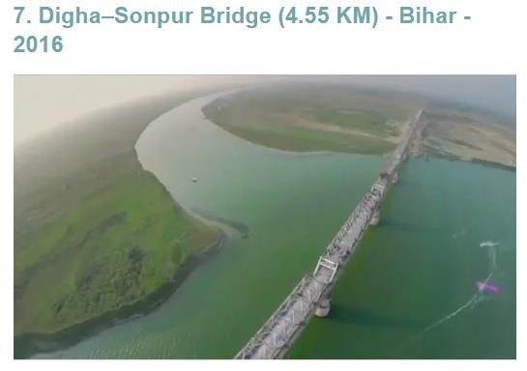

Slide 61
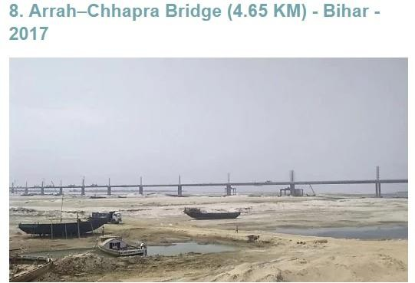

Slide 62
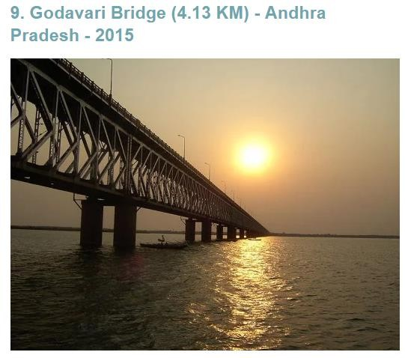

Slide 63
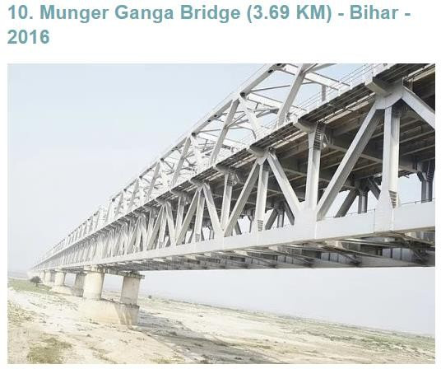

Slide 64

Conclusion
The best way to avoid bridge failures is to expect them to happen and plan for them. It’s the only way to protect the public from injuries, loss of life, property damage and destruction n

